Slide 1


Theme: Location Based Apps
Places To Visit
(Web)
Presented By: Ankit Bansal
Company : Persistent System Pvt. Ltd.

Slide 2

Outline
Why this App
Key Features
Demo
Future Enhancements
Conclusion
Q&A
Places To Visit

Slide 3


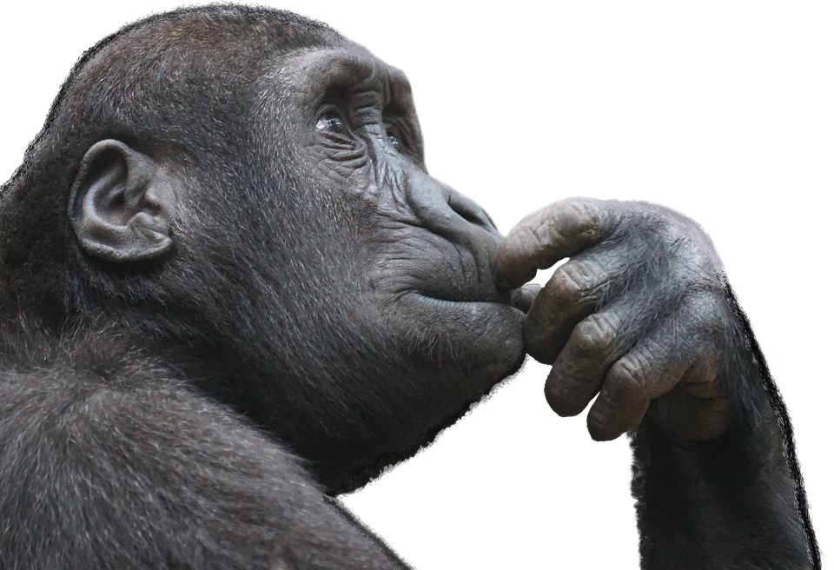

Slide 4
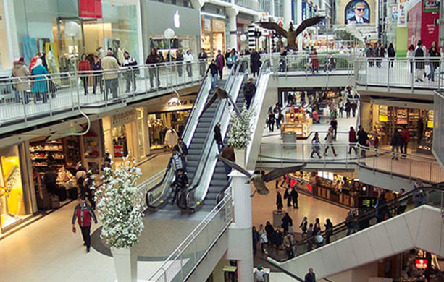

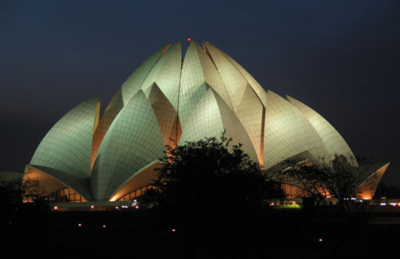
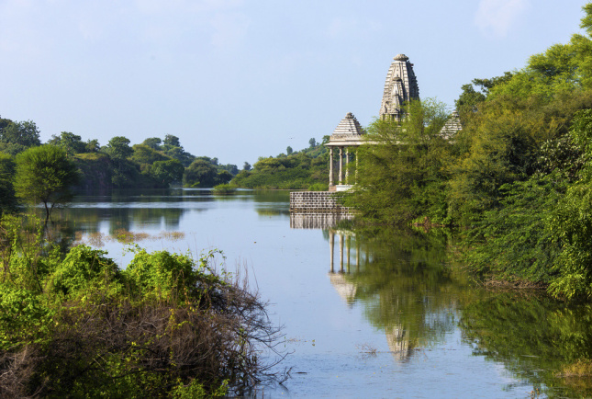
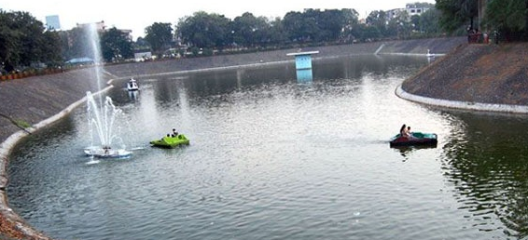

Slide 5
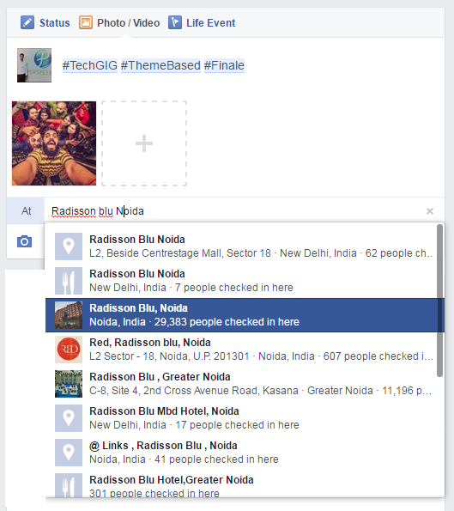

Slide 6



+
facebook Graph API v2.6
Places To Visit

Slide 7
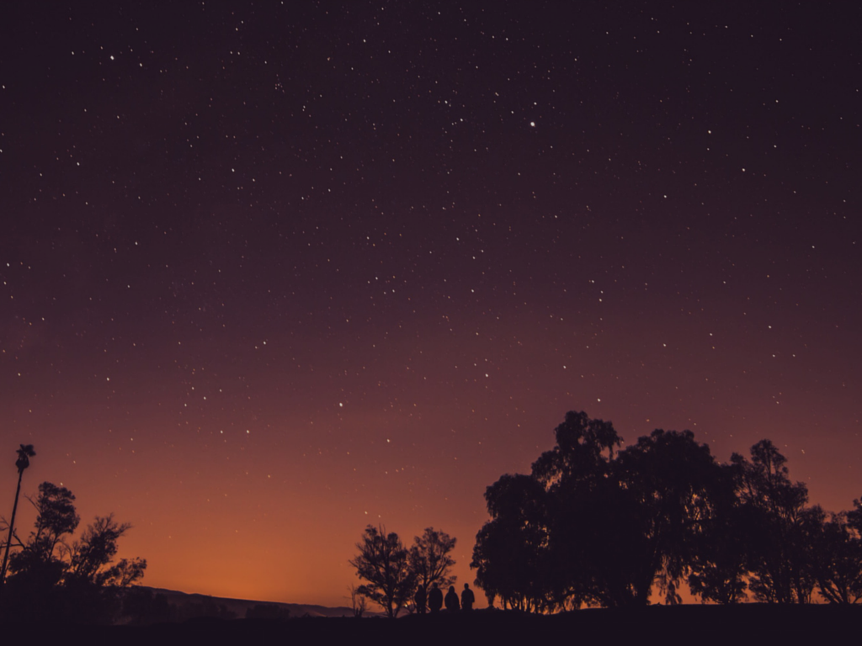
Key Features
Displays Visited Location.
Select Your Interests & get Top Results.
Places List which are Not Visited.
Get Route of Selected Place.
Post to FB.
Ease of use.

Slide 8
DEMO

Slide 9
Enchancements
Suggest Interests based on users sentimental analysis.
Best places to visit.
Places friends has visited and you are remaining.

Slide 10
Thank You :)

Slide 11
Q & A

